Slide 1
Reformation

Slide 2
Christian Humanism
Emphasis on early Church writings that provided answers on how to improve society and reform the Church
Less emphasis on pagan works from ancient Greece and Rome
Drew on Hebrew and Greek texts of the Bible and the writings of the Church Fathers.
Emphasized education and power of human intellect to bring about institutional change and moral improvement.
Writings led to criticism of the church thus leading to the Reformation

Slide 3
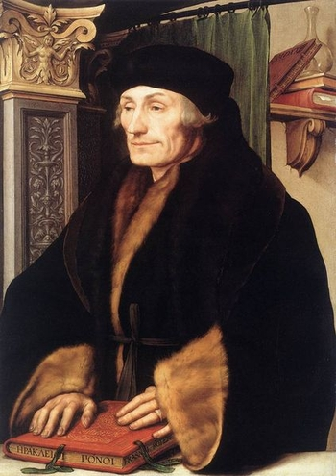
Erasmus
Most famous and celebrated of all Christian humanists
Master of the Greek language; one of Europe’s foremost authorities
Made new translations of the Greek and Latin versions of the New Testament to create “purer” editions.

Slide 4
Calls to Reform the Church
In Praise of Folly - by Erasmus
Best-seller (only the Bible sold more by 1550)
Erasmus was a devout Catholic who sought to reform the Church, not destroy it
Criticized immorality and hypocrisy of Church leaders and the clergy
The book inspired renewed calls for reform, and influenced Martin Luther

Slide 5
THE PROTESTANT REFORMATION
Religious reforms dividing western Christianity
Roman Catholic Church criticized for abuse of power and corruption
Christian Humanists–wanted to reform Church
Believed through reason, and studying the classics one could become more pious(Christ-like)
Desiderius Erasmus–father of Christian Humanism
Suggested reforming from within the Church

Slide 6
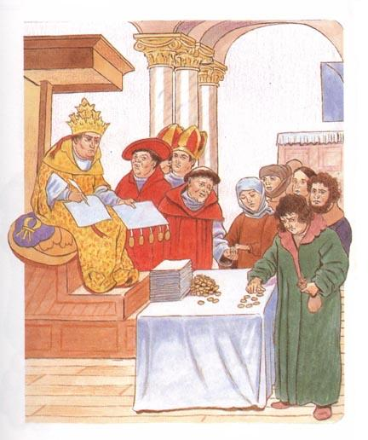
Why reform?
Popes corrupted by power & lose focus of spiritual leadership
People wanted to know how to save souls
Indulgences –a release of a
soul from purgatory for
monetary donation –
a HUGE abuse of
Church power!

Slide 7
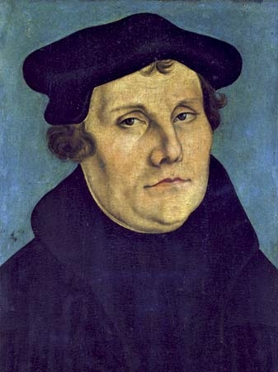
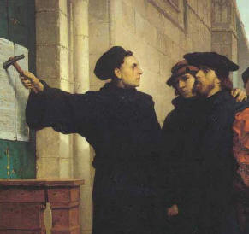
MARTIN LUTHER
German Priest
Saw problems in the Church
Church believed salvation gained
from faith + good work
Luther thought faith alone gained salvation
Oct 31, 1517 – Posted 95 Theses on church door in Wittenburg, Ger
His criticisms of Church
1000s of copies distributed through
Germany

Slide 8
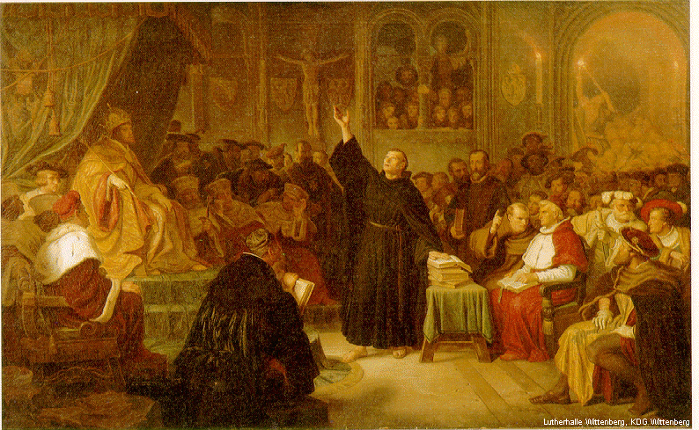
The Reformation Begins
By 1521 Luther moving toward spilt from Church
Wanted Ger princes to overthrow Papal power in Germany & est a German Church
By Jan 1521 – Luther excommunicated
Summoned by Imperial Diet of HRE to Worms
Called by Emperor Charles V,
wanted Luther to change his
ideas, Luther – “NO”
Edict of Worms issued, making
Luther an outlaw
Luther kept in hiding by
his prince

Slide 9
Lutheranism
Followers of Luther’s religious practices
Gained support of many German princes
1524, German peasants revolted & hoped Luther would support them, because Luther needed the princes’ support, he did not help the peasants
Germany in turmoil – Catholic? Lutheran?
To achieve peace HRE Emperor Charles V accepted the Peace of Augsburg (allowed Ger princes to choose the faith of their region)

Slide 10
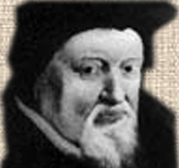
Protestantism Spreads - Zwingli
Ulrich Zwingli – priest in Zurich, Switzerland
Zwinglian Reformation
Banned all religious relics & images
Whitewashed all church interiors
No music in church services
Does note merge w/Luther b/c
can’t agree with the meaning
of communion

Slide 11
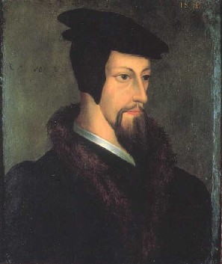
Protestantism Spreads - Calvin
John Calvin replaces Zwingli (killed in rel war)
French, fled for safety to Switzerland
Espoused – predestination
1536 – began reforming Geneva, Switz.
Created a church govt of elect & laity
Used consistory (moral police)
Sent missionaries thru Eur to convert Cath.
Ideas spread → FR, Neth, Scot…
Mid 16th C – Calvinism more pop than Lutheranism

Slide 12
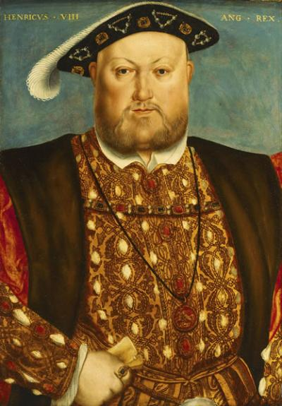
Reformation in England
Political, not religious motives for reform
Henry VIII – King of England
Needs a male heir to carry on
the Tudor Dynasty
Married Catherine of Aragon
(Aunt of Charles V,HRE Emperor)
Have a daughter, Mary
No son, so Henry wants a divorce!
In the Catholic Church, you
need an annulment, granted by the
Church. The Pope grants it for a King.

Slide 13
Reformation in England (cont)
The Pope refused to grant the annulment, too political (King of Eng vs. HRE Emperor)
After a long argument, Henry decided to break from Catholic Church
Archbishop of Canterbury granted divorce
Act of Supremacy(1534) est Church of Eng
King control over doctrine, appointments, etc
Dissolves Cath claims, sells land & possessions
Remained close to Cath teachings

Slide 14
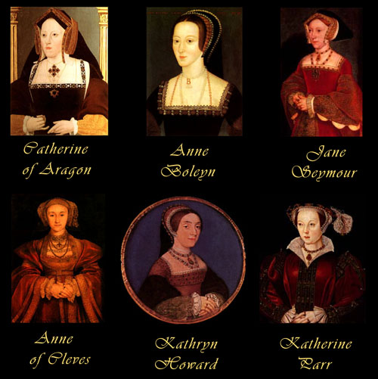
Henry & his wives
Henry was desperate for a son. So much so he married 6 times!!
The saying goes…
Divorced, Beheaded, Died
Divorced, Beheaded, Survived

Slide 15
The Church of England
1547 – Henry died
His 9 year old son, Edward VI, took the throne
The Church of England- aka Anglican Church
Became more Protestant
Angering Catholics
1553 – Edward dies
His half-sister Mary (Catholic) takes throne
She wants to restore Catholicism
“Bloody Mary” has 300+ Prot burned as heretics
Increases tensions btw Cath & Prot

Slide 16
The Anabaptists
Separate selves from other Prot
Adult baptism
Dislike govt interference
Refuse political office, bear arms (pacifists), etc
See all people as equal
Viewed as extremely radical
Modern descendents
Amish, Mennonites, German Baptists

Slide 17
The Catholic Reformation
Protestantism spreading rapidly through Eur
Church sees need to reform
Pillars of Catholic Reformation
1. Society of Jesus (Jesuits)
Ignatius of Loyola, began missions to restore Church
2. Reform of Papacy – started by Pope Paul III
3. Council of Trent – met off & on for 18 years
Reaffirmed traditional Cath beliefs
Incl the 7 sacraments & faith and good works
Banned selling indulgences!

